Slide 1
2023-01-23

Slide 2
Unit 7 Project

Slide 3
The week to come
1/23 Monday: Work on Unit 7 Project
1/25 Wednesday: Work on Unit 7 Project
1/27 Friday: Unit 7 Review
1/30 Monday: No class
2/1 Wednesday: Unit 7 Test

Slide 4
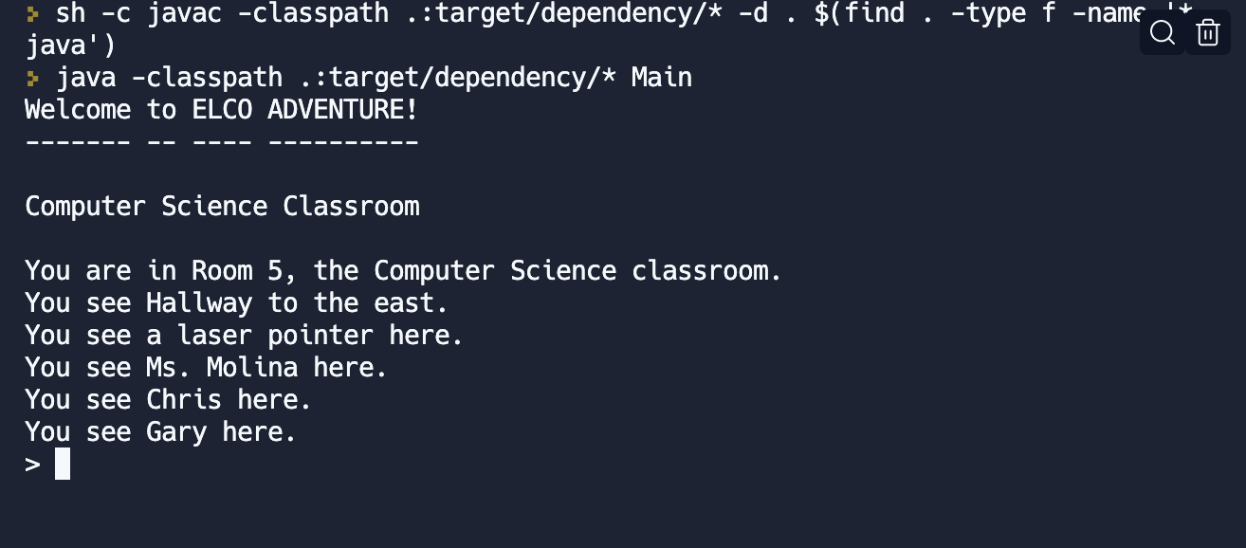

Slide 5
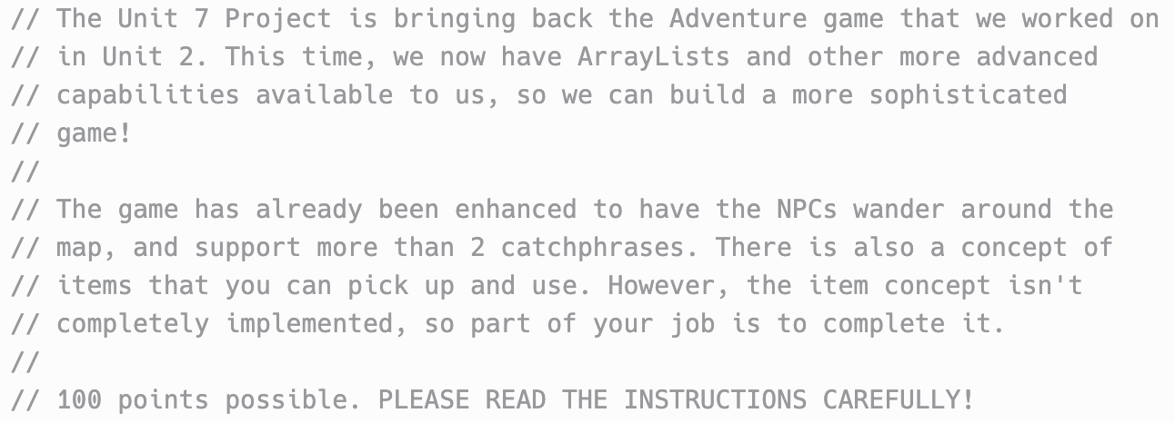

Slide 6
Requirements
1. You must add at least 3 new rooms to the map, and there should be some creativity on display, not "Room A" "Room B" "Room C". You can add to the map that's already in the game, or you can start with a completely new map of your own. (15 pts)
2. You must add at least 3 new NPCs to the game. (15 pts)
3. You must add at least 3 new items to the game. (15 pts)

Slide 7
Requirements cont'd
4. Implement the command "inventory" to list out the items the player is holding. The list of items should be displayed in alphabetical order! (10 pts)
5. Implement the command "get" to pick up an item in a room. This should add the item to the player's inventory, and remove it from the room's item list. Obviously, a player should only be able to pick up items that are actually in the room. Appropriate error messages should be displayed if the user does something impossible, like trying to get an item that isn't there. (10 pts)

Slide 8
Requirements cont'd
6. Implement the command "drop" to drop an item in a room. This should remove the item from the player's inventory, and add it to the room's item list. Obviously, a player should only be able to drop items they are holding, and appropriate error messages should be displayed if they aren't. (10 pts)
7. Implement an "examine" command which prints out the description of an item either in the player's inventory or in the room where the player is. An error should be displayed if the user isn't holding the item and the item isn't in the user's current location. (10 pts)
8. Implement at least one command that only works when the player is holding a certain item. The command might only work in a specific room, too. For instance, a key might be used to unlock a door, or some money might be used to purchase another item, or a BART ticket might be used to ride a BART train. (15 pts)

Slide 9
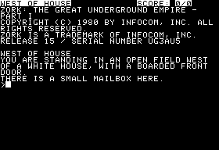

Slide 10
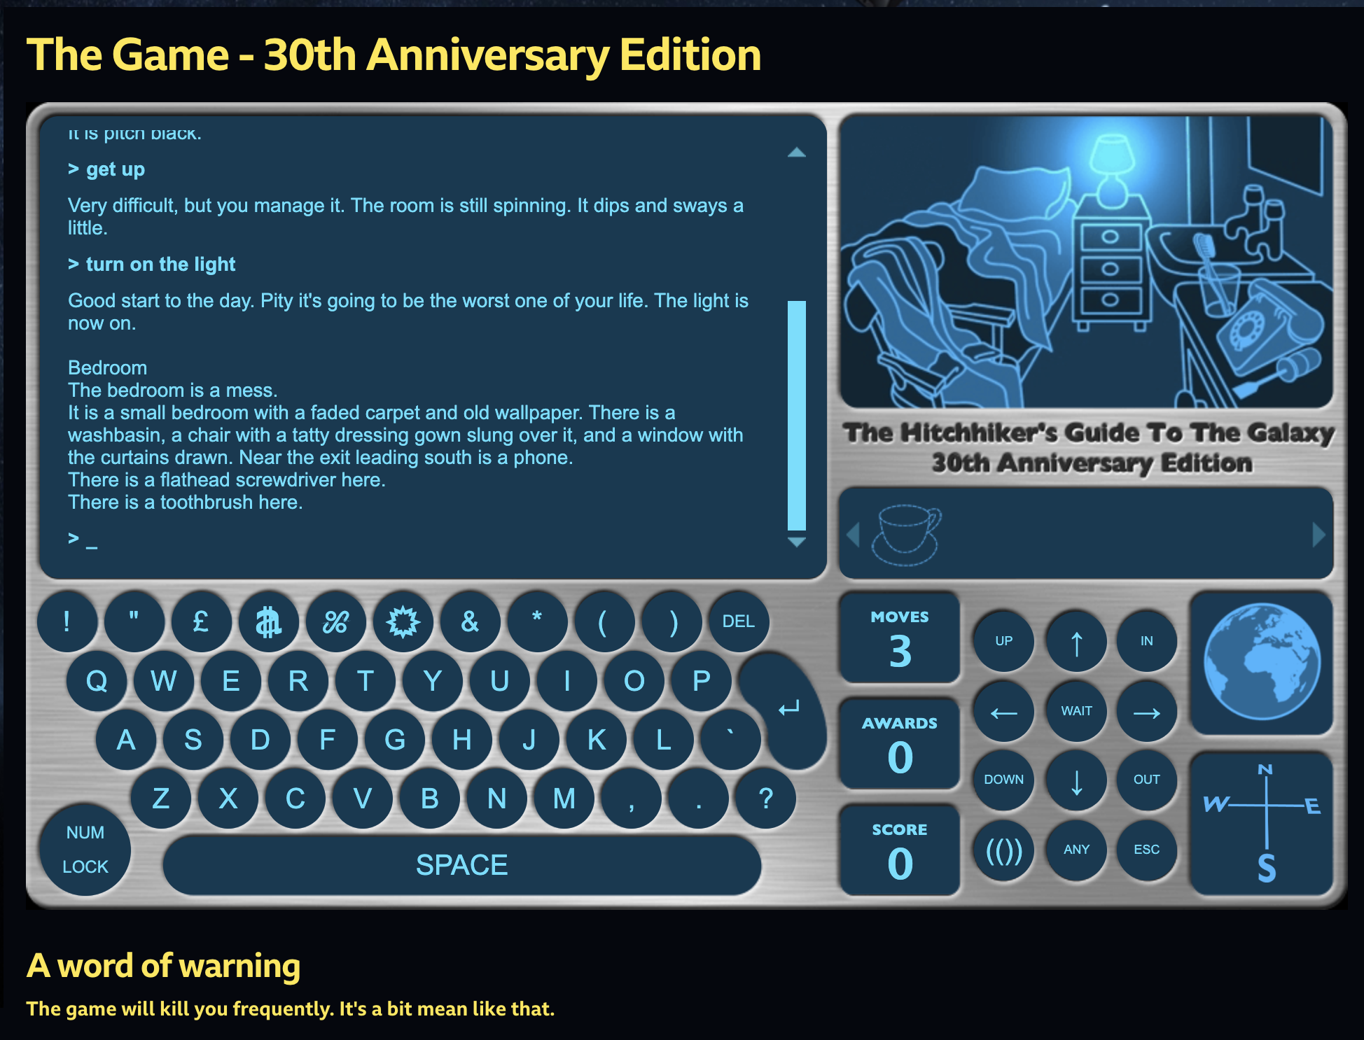
https://www.bbc.co.uk/programmes/articles/1g84m0sXpnNCv84GpN2PLZG/the-game-30th-anniversary-edition

Slide 11
Repl.it: Unit 7 Project
https://replit.com/@MsMolinaECHS/Unit-7-Project#Game.java

